Slide 1

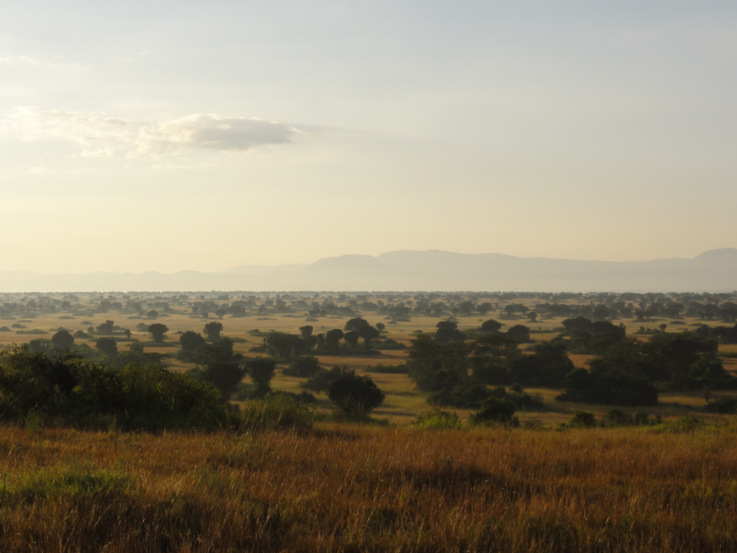

Stability Analysis of Rainforest
1, 2, 3

Slide 2
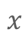
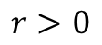
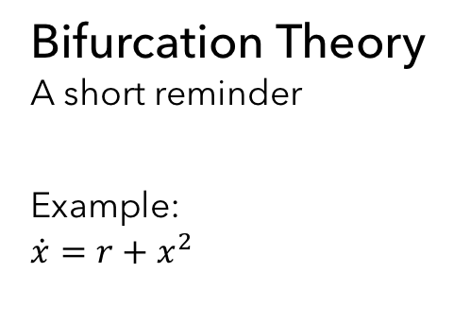
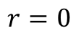
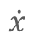
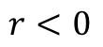
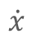
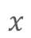
Bifurcation Theory
A short reminder
Example:
$$\dot{x}=r+x^{2}$$
$$\dot{x}$$
$$\dot{x}$$
$$\dot{x}$$
$$x$$
$$x$$
$$x$$
$$r<0$$
$$r=0$$
$$r>0$$

Slide 3
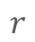
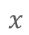
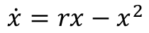
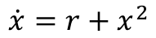
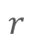
Bifurcation Diagrams
Critical slowing down, Transcritical Bifurcation
$$x$$
$$x$$
$$r$$
$$r$$
$$\dot{x}=r+x^{2}$$
$$\dot{x}=rx−x^{2}$$

Slide 4

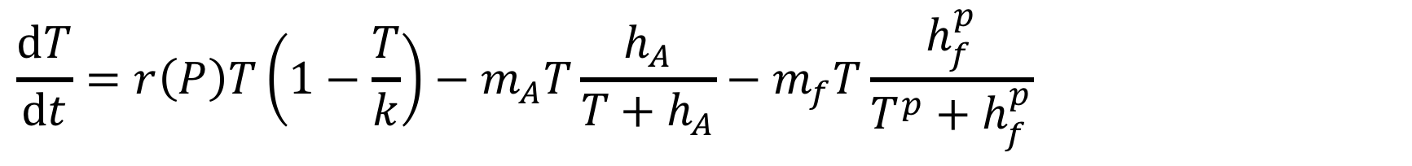
Tree-Cover Model
Dynamics of Tree-Cover ($T$ in $\%$) in dependence of Precepitation ($P$ in $mm∙{\text{yr}}^{−1}$)
Logistic growth
K … maximum Tree-Cover
$$\frac{\text{d}T}{\text{d}t}=r\left(P\right)T\left(1−\frac{T}{k}\right)−m_{A}T\frac{h_{A}}{T+h_{A}}−m_{f}T\frac{h_{f}^{p}}{T^{p}+h_{f}^{p}}$$

Slide 5
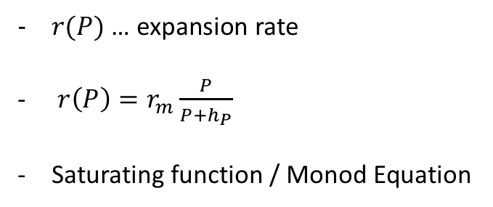
Tree-Cover Model
Expansion rate
$r(P)$ … expansion rate
$r\left(P\right)=r_{m}\frac{P}{P+h_{P}}$
Saturating function / Monod Equation
$$\frac{\text{d}T}{\text{d}t}=r\left(P\right)T\left(1−\frac{T}{k}\right)−m_{A}T\frac{h_{A}}{T+h_{A}}−m_{f}T\frac{h_{f}^{p}}{T^{p}+h_{f}^{p}}$$

Slide 6
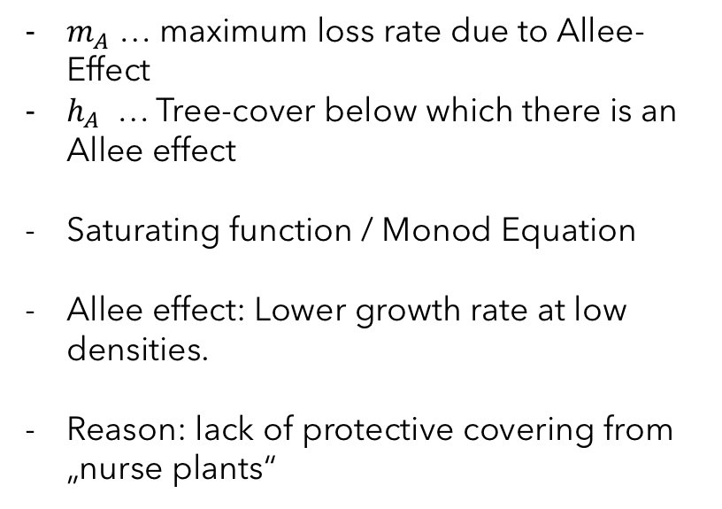
Tree-Cover Model
Allee effect
$m_{A}$ … maximum loss rate due to Allee-Effect
$h_{A}$ … Tree-cover below which there is an Allee effect
Saturating function / Monod Equation
Allee effect: Lower growth rate at low densities.
Reason: lack of protective covering from „nurse plants“
$$\frac{\text{d}T}{\text{d}t}=r\left(P\right)T\left(1−\frac{T}{k}\right)−m_{A}T\frac{h_{A}}{T+h_{A}}−m_{f}T\frac{h_{f}^{p}}{T^{p}+h_{f}^{p}}$$

Slide 7
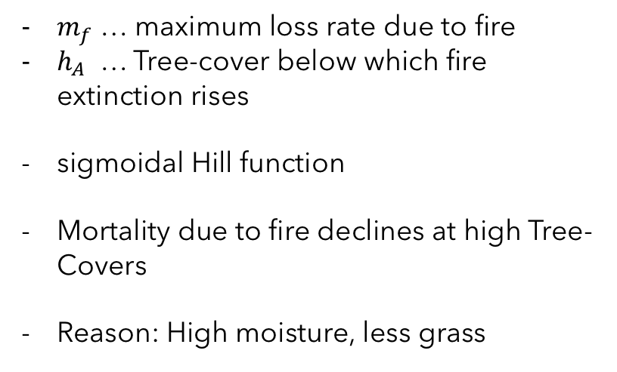
Tree-Cover Model
Allee effect
$m_{f}$ … maximum loss rate due to fire
$h_{A}$ … Tree-cover below which fire extinction rises
sigmoidal Hill function
Mortality due to fire declines at high Tree-Covers
Reason: High moisture, less grass
$$\frac{\text{d}T}{\text{d}t}=r\left(P\right)T\left(1−\frac{T}{k}\right)−m_{A}T\frac{h_{A}}{T+h_{A}}−m_{f}T\frac{h_{f}^{p}}{T^{p}+h_{f}^{p}}$$

Slide 8
Tree-Cover Model
Stable solutions

Slide 9
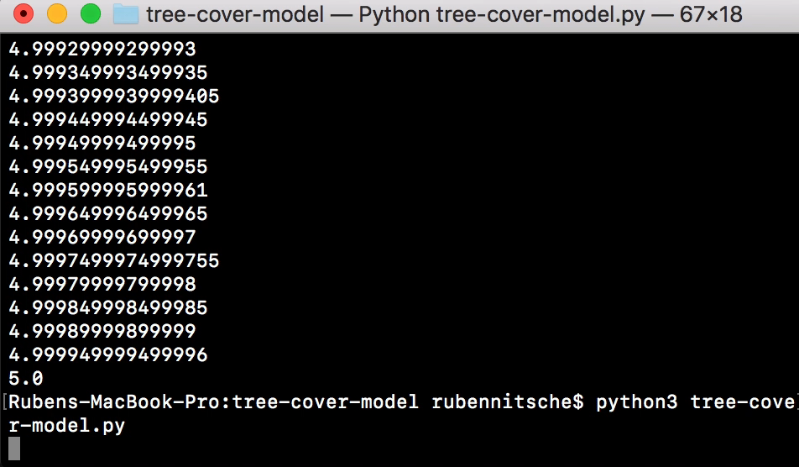
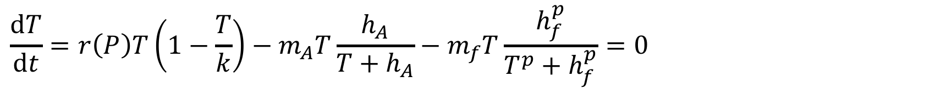
Tree-Cover Model
Solving the differential equation
$$\frac{\text{d}T}{\text{d}t}=r\left(P\right)T\left(1−\frac{T}{k}\right)−m_{A}T\frac{h_{A}}{T+h_{A}}−m_{f}T\frac{h_{f}^{p}}{T^{p}+h_{f}^{p}}=0$$
!
Look roughly for a sign change
Use the Newton-Algorithm look for the zero poins
Let the Computer do ist magic

Slide 10
Tree-Cover Model
Bifurcation diagram

Slide 11
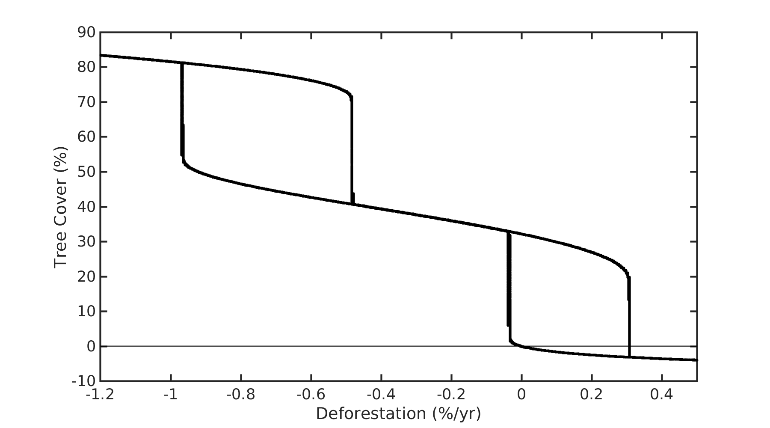
Variation of Deforestation

Slide 12
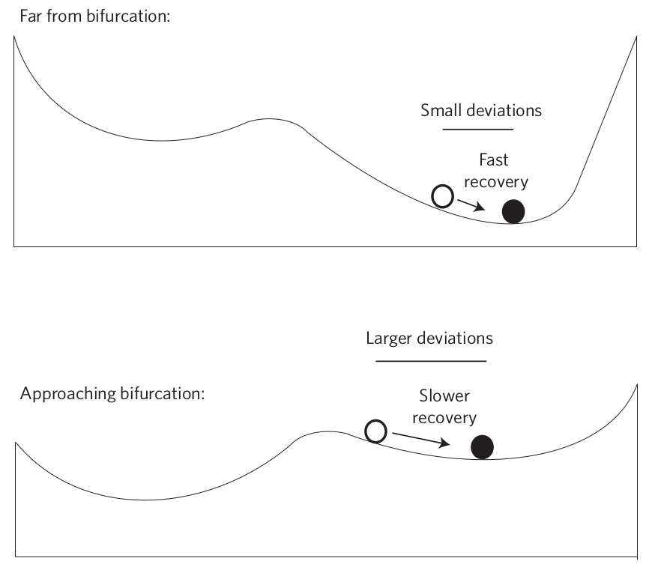
Recovery rate from perturbations
Recovery from small perturbations is slowed down in proximity to a bifurcation
4

Slide 13
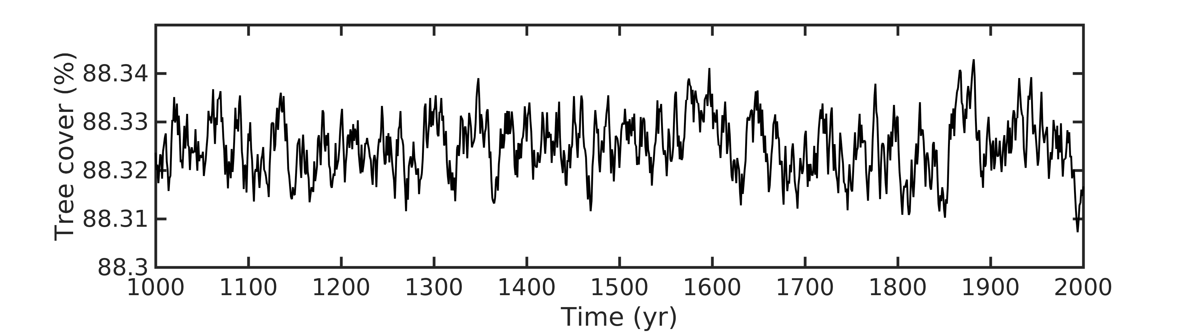
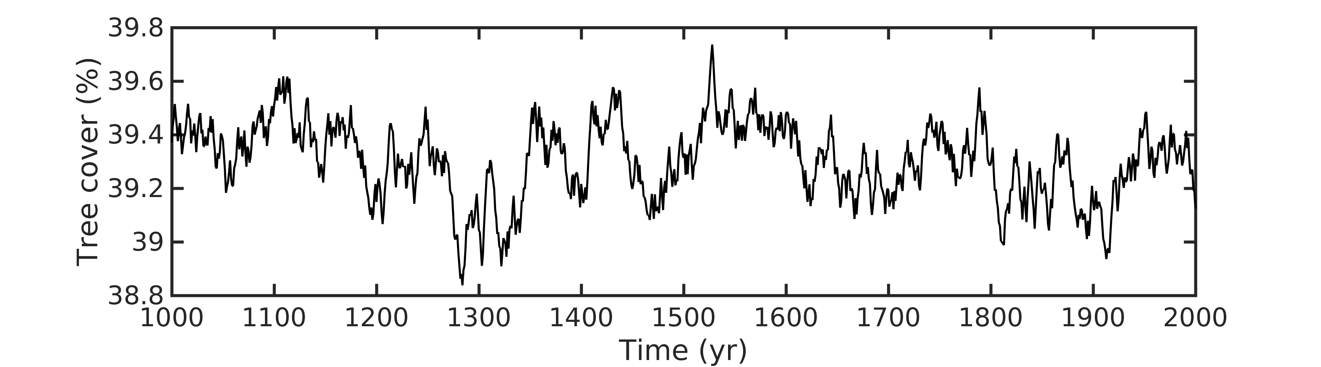
Introducing an artificial perturbation
Much slower recovery rate close to the rainforest → savanna bifurcation

Slide 14
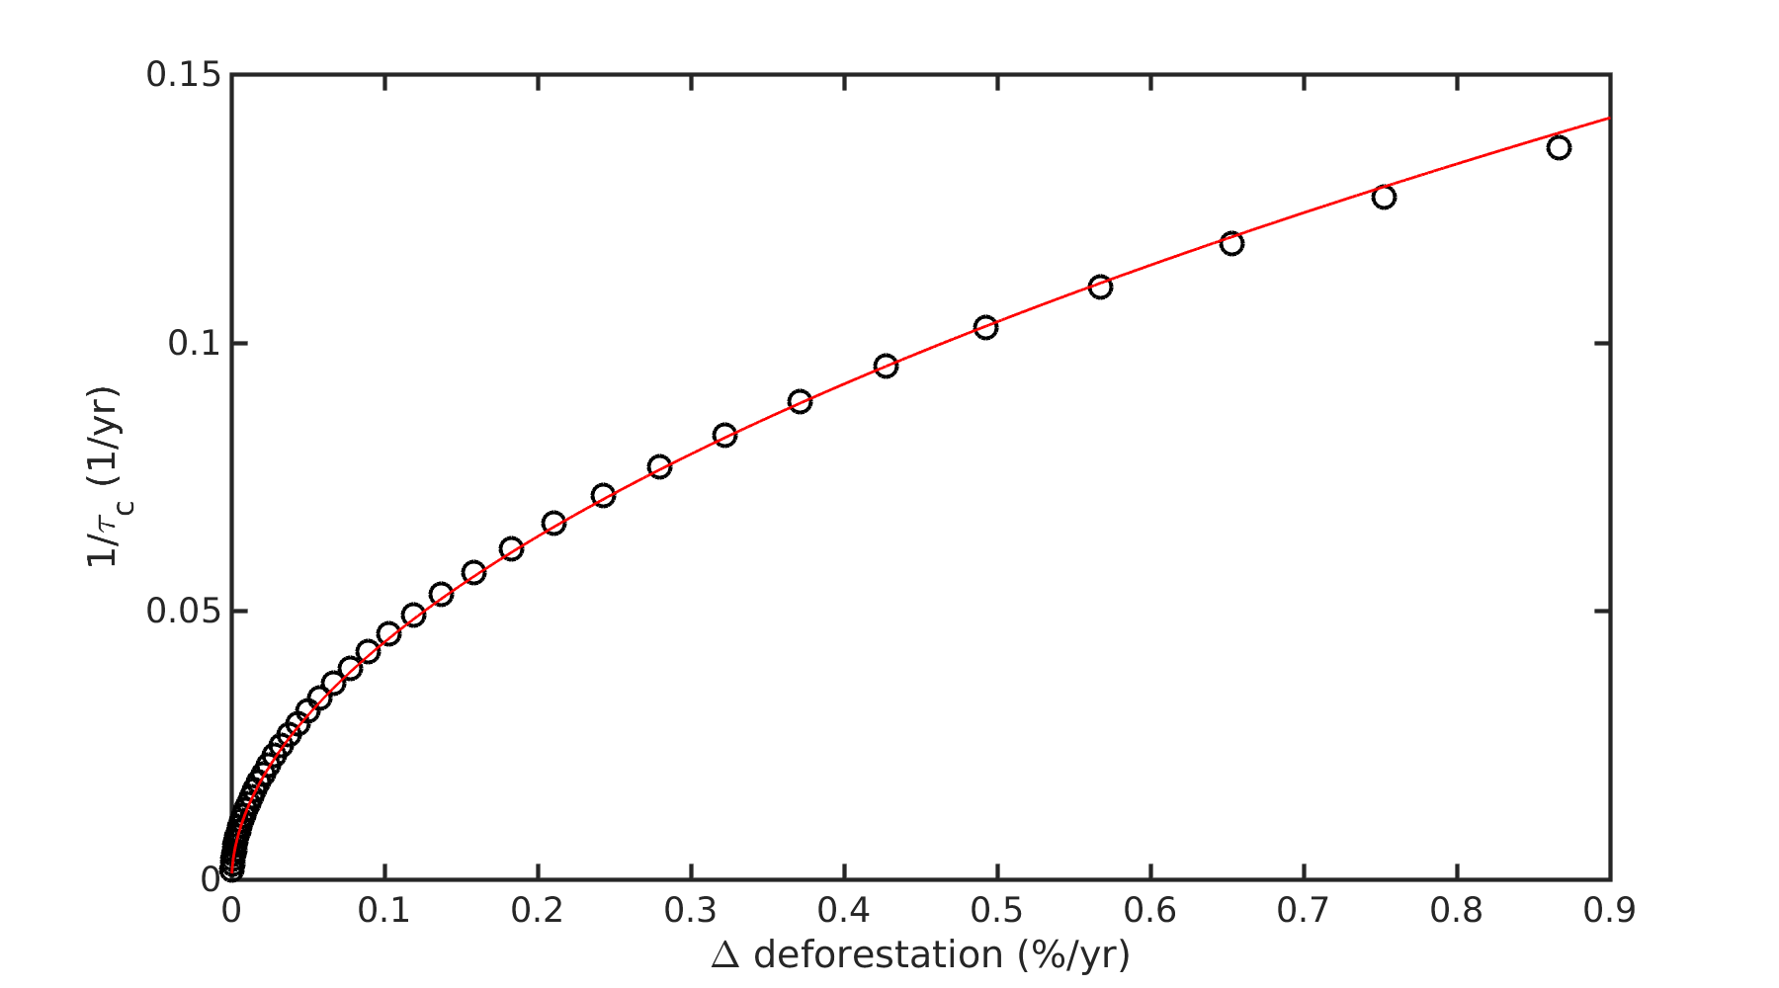
Recovery rate
Variation of the recovery rate as a function of the system state can be used to predict proximity to a bifurcation

Slide 15
Variation and autocorrelation
Both variation and autocorrelation under random perturbations are increased in proximity to a bifurcation
4

Slide 16
Variation and autocorrelation
Much higher variation and autocorrelation close to the rainforest
→ savanna bifurcation

Slide 17
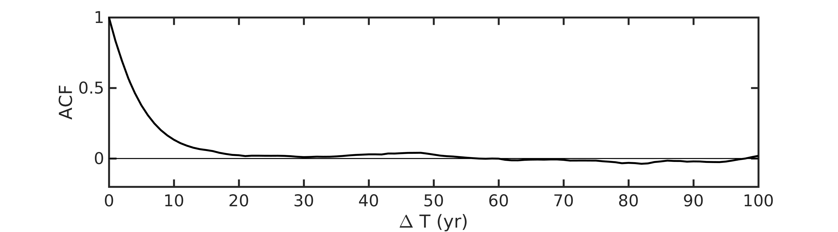
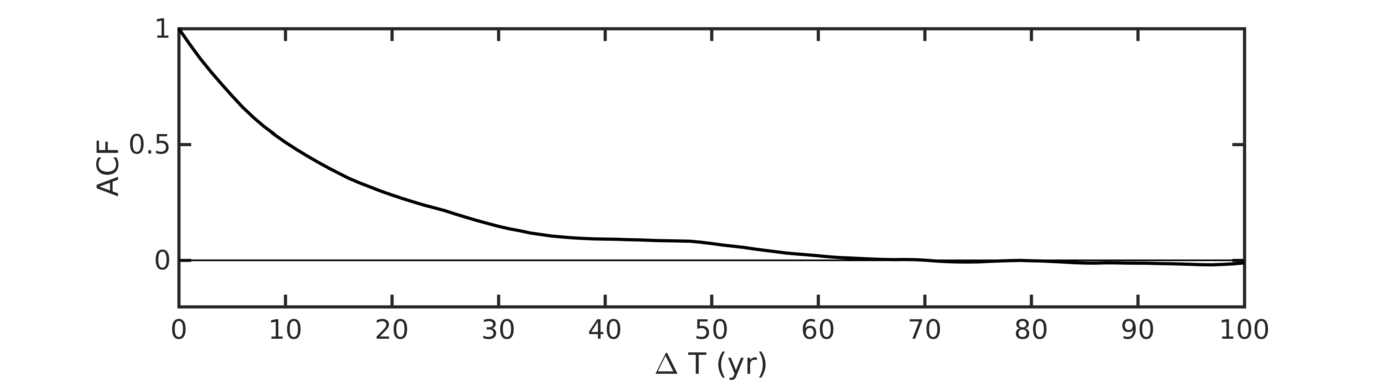
Autocorrelation function
Slope of the autocorrelation function as a conveniant measure

Slide 18
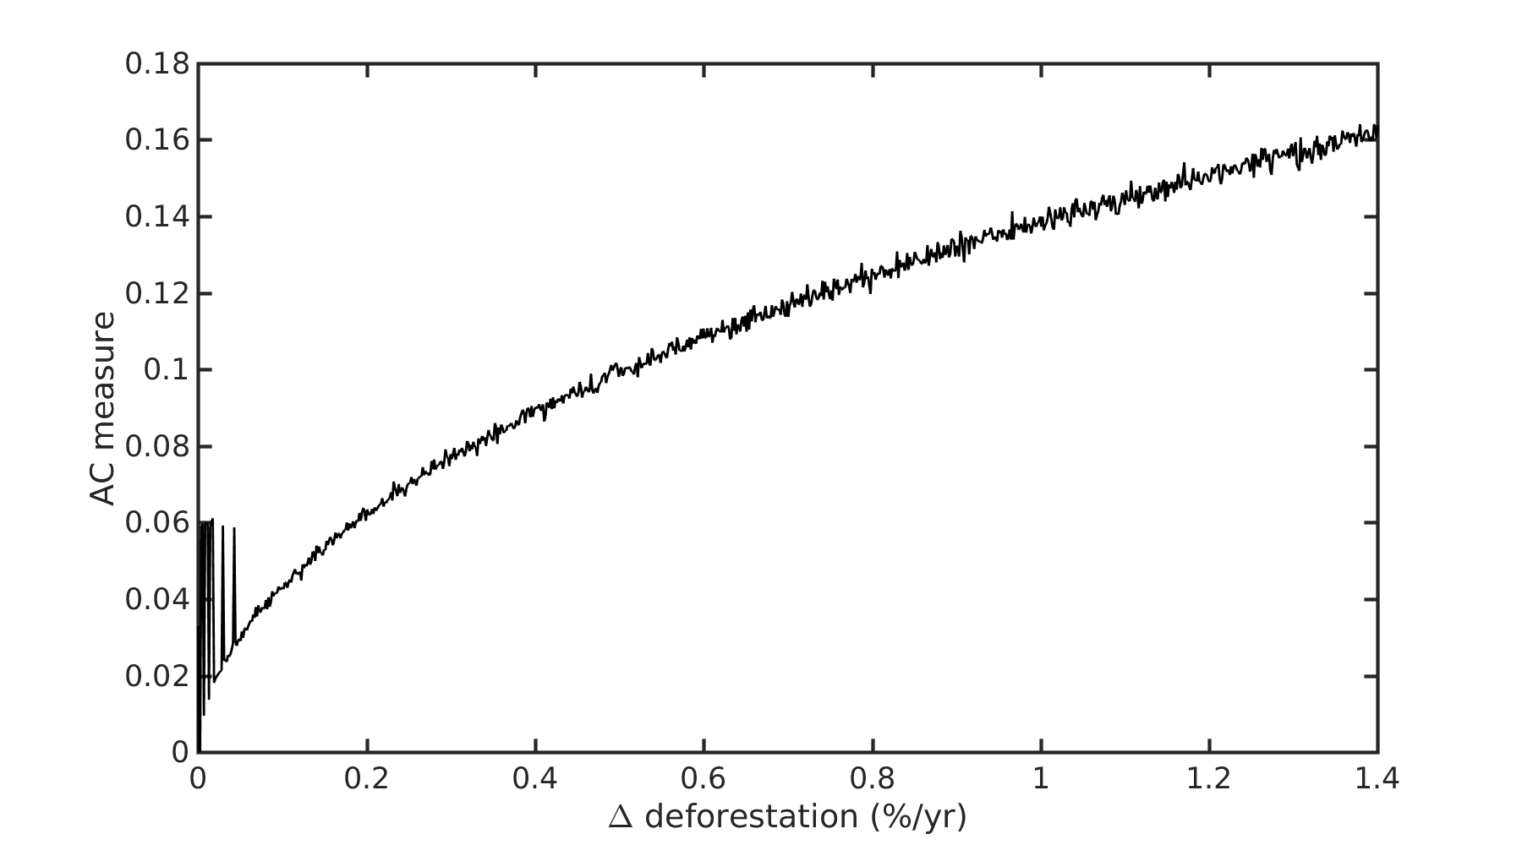
Autocorrelation
Theoretically, early warning of a bifurcation is possible,
Practical use of straightforward early warning signals is not robust, can be supplemented by detailed modeling effort

Slide 19
Thank you for your attention

Slide 20
References
- Tipping points in tropical tree cover: linking theory to data
Egbert H. van Nes et al., 2014
Pictures / Figures
1 – Ben Britten, rainforest, CC BY 2.0
2 – Michele Zanin, Savanna in the morning, CC BY-SA 2.0
3 – Gerben van Heijningen, Desert, CC BY-NC 2.0
4 – Early warning of climate tipping points,
Timothy M. Lenton, Nature Climate Change volume 1, pages 201–209 (2011),
Figure 1.

